Slide 1
Introduction to Information Security
"Begin at the beginning, " the King said, very gravely,
"and go on till you come to the end: then stop."
— Lewis Carroll, Alice in Wonderland
Course Instructor: Dr. Zainab Abaid

Slide 2
Agenda
Course Policies and Information
Defining Information Security
Fun Stats
Closer to Home
Security in the 21st Century
Case Studies: Heart Bleed, SQL Injection, DDoS attacks, uffer overflow
Challenges to Securing Information
CIA Triad and Beyond
Anatomy of a Hack
Attackers
Overall Cybersecurity Strategy
Principles for Defense and Design

Slide 3
Course Outline (Tentative)
Week 1: Introduction to information security. Risk management
Week 2: Modern malware and attacks.
Week 3: Access, Authorization and Auditing
Week 4 – 6: Cryptography
Week 7 - 10: Web Security
Week 11 - 12: Network Security
Week 13: Incident Response; Cybersecurity Laws and Policies

Slide 4
Assessment Item Weightage
Assessment Item | Weightage
Quizzes/Lab Tasks | 10
Assignments | 15
Sessional Exam(s) | 25
Project | 10
Final Exam | 40

Slide 5
Class Policies
Attendance: marked present if you are present whenever I take the attendance, no late marking.
Attendance errors: Check and fix during class, no retrospective changes.
Submissions: No late submissions in any circumstances
Plagiarism: Minimum penalty is a zero for all involved parties, more severe consequences depending on circumstances.
Marking Queries: Within 24 hours of release of marks of any item, no retrospective changes at all.
Class Etiquettes: No talking when I talk, no sleeping, no leaving early unless you have prior permission.

Slide 6

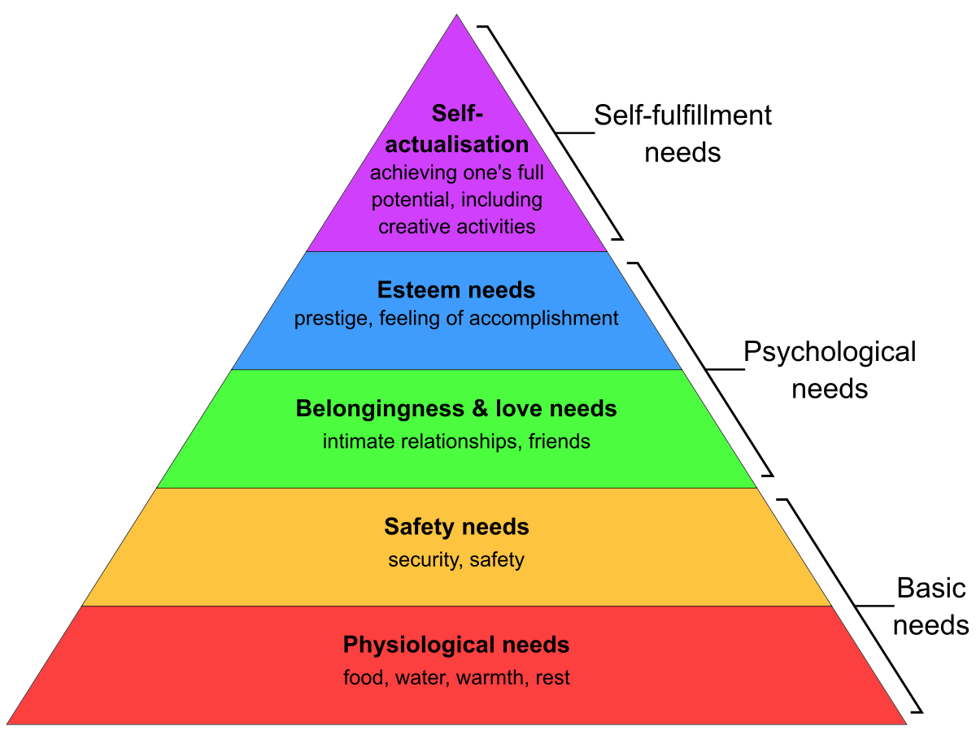
Understanding Security
Notes:
https://sonitrolsecurity.com/how-the-archaeological-periods-relate-to-security/
Maslows hierarchy of needs

Slide 7
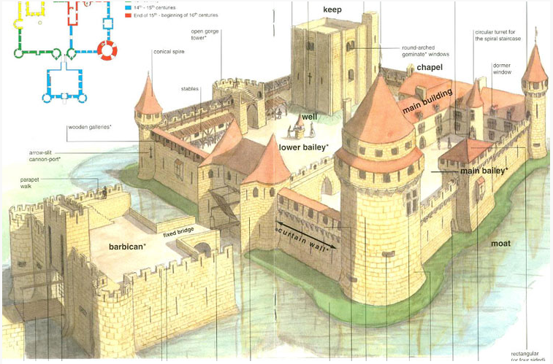
Medieval Castle
Notes:
Security
The goal to be free from danger
The process that achieves that freedom
Harm/danger may come from one of two sources:
From a direct action that is intended to inflict damage
From an indirect and unintentional action
As security is increased, convenience is often decreased
before defense is possible, one must understand:
Exactly what security is
How security relates to information security
The terminology that relates to information security
-medieval fortification: https://newamericancastle.org/security/#prettyPhoto

Slide 8
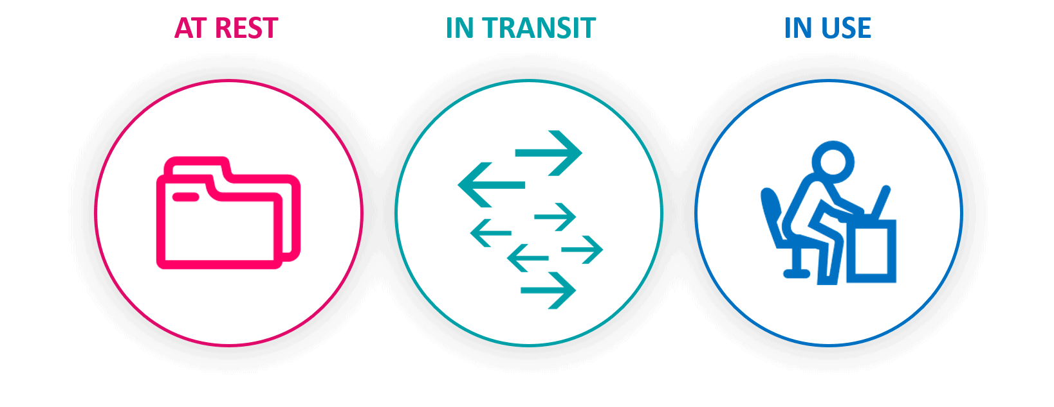
Information Security
Information security - the tasks of securing information that is in a digital format:
Buzzwords: network security, computer security, cybersecurity, database security
Notes:
three states of data: at rest, in transit, in use,
info sec subsumes network security, computer security, cybersecurity, database security

Slide 9
Fun Stats
Over $5 trillion will be spent on Cybersecurity in the next 5 years
A business falls victim to a ransomware attack every 11 seconds and will every 2 seconds by 2031.
Cyber crime incurs global costs of $6 trillion. It is expected to increase to over $ 10 trillion by 2025
Out of 330 million active monthly users, around 16.5 million are bots on Twitter (5%)
Phishing attacks are responsible for more than 80% of reported security incidents.
Cybercrime Skyrockets 300% Since COVID-19
Human Error is Responsible for 82% of Data Breaches
77% organizations are ill prepared to defend against cyber attacks
Notes:
https://www.amazon.com/CompTIA-Security-Analyst-MindTap-Course/dp/0357541375
https://cybersecurityventures.com/cybercrime-damage-costs-10-trillion-by-2025/
https://www.dqindia.com/ransomweary-businesses-need-to-scale-up-their-data-protection-strategies/
https://www.intelice.com/cybercrime-skyrockets/
https://www.information-management.com/news/most-organizations-ill-prepared-to-defend-against-cyber-attacks
https://spanning.com/blog/cyberattacks-2021-phishing-ransomware-data-breach-statistics/
https://www.makeuseof.com/how-many-bots-on-twitter/

Slide 10

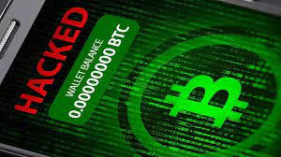
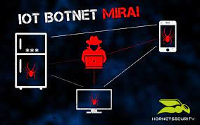

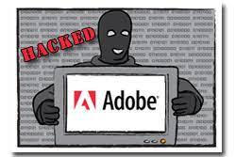
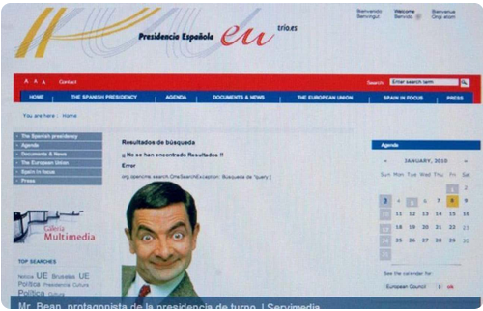
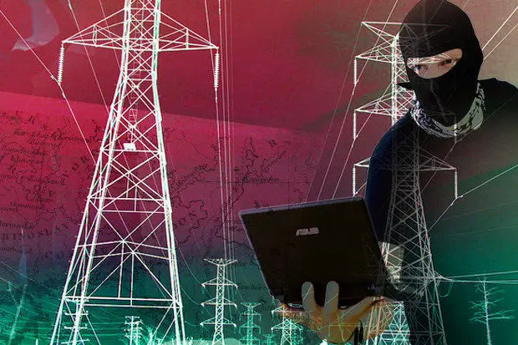

Today’s Security Attacks
Notes:
https://www.networkworld.com/article/3022766/ukrainian-power-grid-hack-what-happened-and-what-needs-to-change.html
https://www.hackread.com/indian-pm-modi-twitter-account-hacked-bitcoin-scam/
https://www.nytimes.com/2020/03/20/style/zoombombing-zoom-trolling.html
https://www.csoonline.com/article/3258748/the-mirai-botnet-explained-how-teen-scammers-and-cctv-cameras-almost-brought-down-the-internet.html

Slide 11
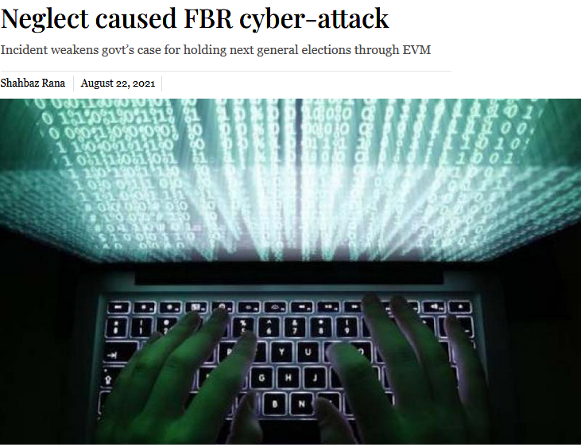
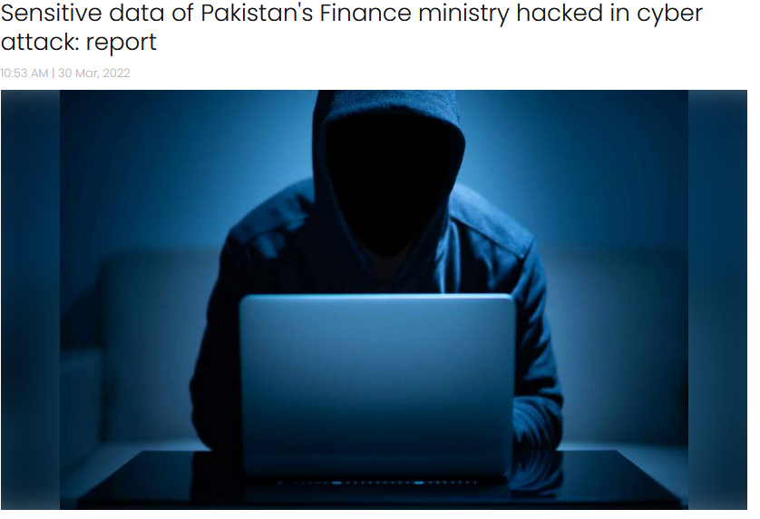
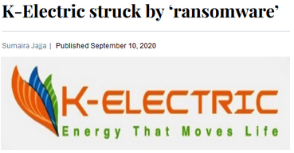
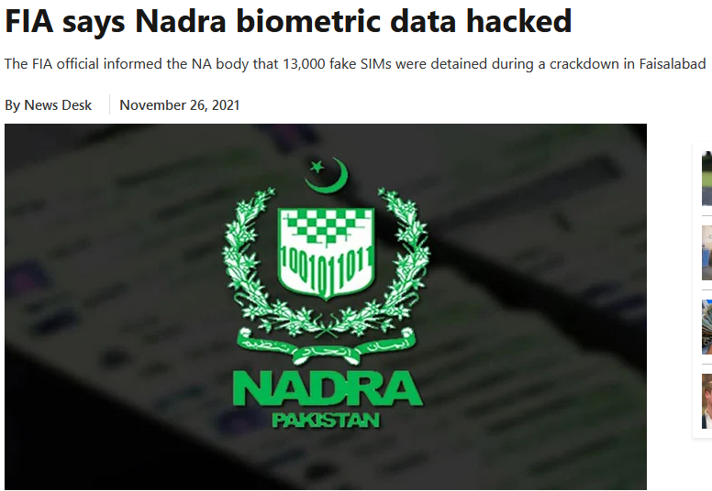
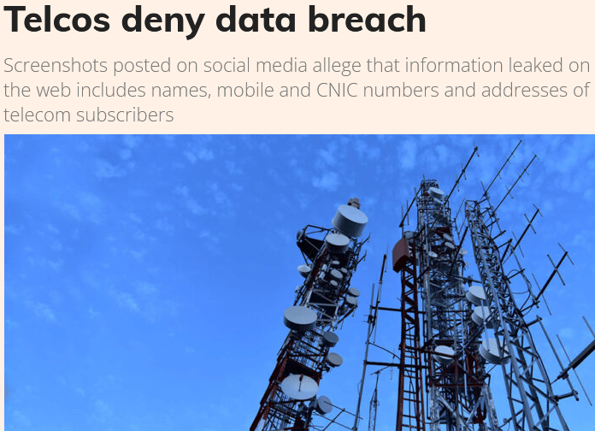
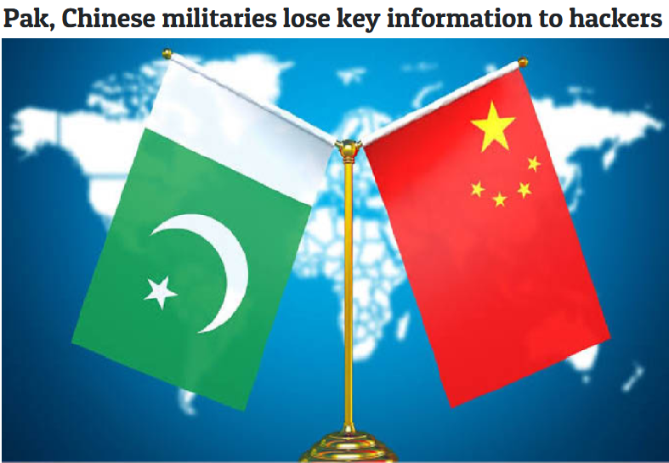
Close to Home
Notes:
https://www.dawn.com/news/1578882
https://www.sundayguardianlive.com/world/pak-chinese-militaries-lose-key-information-hackers
https://www.thenews.com.pk/print/945811-finance-ministry-data-hacked-three-months-ago
https://www.thenews.com.pk/print/911801-fia-says-nadra-biometric-data-hacked
https://tribune.com.pk/story/2316604/neglect-caused-fbr-cyber-attack
https://profit.pakistantoday.com.pk/2022/01/18/telcos-deny-data-breach/

Slide 12
Security figures prominently in 21st century world
Information security continues to rank as
the number one concern of IT managers

Slide 13
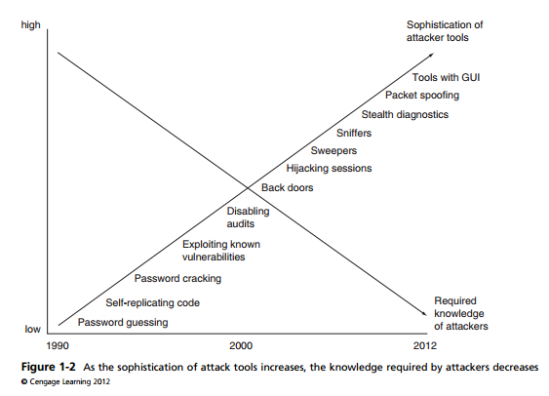
Challenges in defending against attacks
Universally connected devices
Increased Speed of attacks
Greater sophistication of attaches
Availability and simplicity of attack tools
Faster detection of vulnerabilities
Delayed security updating
Distributed attacks
BYOD
A battle of wits between attacker / admin
It is not perceived on benefit until fails
Too often an after-thought (not integral)
Regarded as impediment to using system
Notes:
Difficulties in Defending Against Attacks
Universally connected devices: It is unthinkable today for any technology device—desktop computer, tablet, laptop, or smartphone—not to be connected to the Internet.
Increased speed of attacks: With modern tools at their disposal, attackers can quickly scan millions of devices to
find weaknesses and launch attacks with unprecedented speed.
Greater sophistication of attacks: Attackers today use common Internet protocols and applications to perform attacks, making it more difficult to
distinguish an attack from legitimate traffic.
Availability and simplicity of attack tools: Today’s software attack tools do not require any sophisticated knowledge on the part of the attacker. In fact, many of the tools, such as the Kali Linux have a graphical user interface (GUI) that allows the user to easily select options from a menu.
Faster detection of vulnerabilities: Weakness in hardware and software can be more quickly uncovered and exploited with new software tools and techniques.

Slide 14
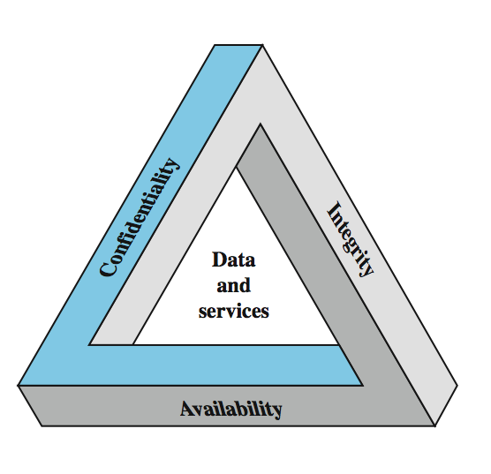
Information Security Triad
Three common core goals, referred to as CIA:
Confidentiality
Data confidentiality
Privacy
Integrity
Data and System integrity
Source Integrity
Availability
Notes:
Confidentiality
Data confidentiality: Assures that data must be protected from unauthorized access, use, or disclosure while in storage, in process, and in transit.
Privacy: Assures that individual control or influence what information may be collected and stored
Integrity
Data and System integrity: assures that information and programs are changed only in a specified and authorized manner
Source Integrity
Availability: assure that systems works promptly and service is not denied to authorized users

Slide 15
Confidentiality: Threats & Countermeasures
•Numerous attacks focus on the violation of confidentiality. These include:
–capturing network traffic
–stealing password files
–social engineering
–port scanning,
–eavesdropping, sniffing, and so on.
Violations of confidentiality are not limited to directed intentional attacks.
Events that lead to confidentiality breaches include
by not encrypting it before sending it to another person,
by falling prey to a social engineering attack,
by sharing a company’s trade secrets, or by not using extra care to protect confidential information when processing it.
documents left on printers, or even walking away from an access terminal while data is displayed on the monitor.
Numerous countermeasures
Encryption for data at rest (whole disk, database encryption)
Encryption for data in transit (IPSec, TLS, PPTP, SSH)
Access control (physical and technical)

Slide 16
Integrity: Threats and Countermeasures
Events that lead to integrity breaches include (non-intentional)
accidentally deleting files
entering invalid data
altering configurations
Countermeasures
Hashing (data integrity)
Configuration management (system integrity)
Access control (physical and technical)
Software digital signing
Transmission cyclic redundancy check (CRC) functions

Slide 17
Availability: threats & countermeasures
There are numerous threats to availability.
These include device failure, software errors, and environmental issues (heat, static, flooding, power loss, and so on).
There are also some forms of attacks that focus on the violation of availability, including DoS attacks, and communication interruptions.
Countermeasures
Redundant array of independent disks (RAID)
Load balancing
Redundant data and power lines
Software and data backups
Co-location and offsite facilities
Rollback functions
Failover configurations

Slide 18
Examples of Security Requirements: Confidentiality
Student grade information is an asset whose confidentiality is considered to be very high
The US FERPA Act: grades should only be available to students, their parents, and their employers (when required for the job)
Student enrollment information: may have moderate confidentiality rating; less damage if enclosed
Directory information: low confidentiality rating; often available publicly

Slide 19
Examples of Security Requirements: Integrity
A hospital patient’s allergy information (high integrity data): a doctor should be able to trust that the info is correct and current
If a nurse deliberately falsifies the data, the database should be restored to a trusted basis and the falsified information traced back to the person who did it
An online newsgroup registration data: moderate level of integrity
An example of low integrity requirement: anonymous online poll (inaccuracy is well understood)

Slide 20
Examples of Security Requirements: Availability
A system that provides authentication: high availability requirement
If customers cannot access resources, the loss of services could result in financial loss
A public website for a university
a moderate availably requirement; not critical but causes embarrassment
An online telephone directory lookup
a low availability requirement because unavailability is mostly annoyance (there are alternative sources)

Slide 21
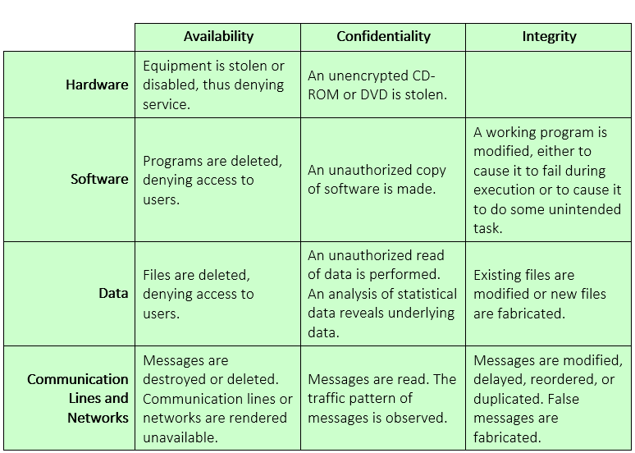
Activity

Slide 22
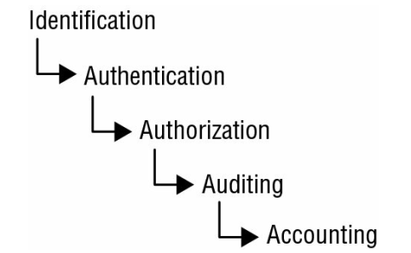
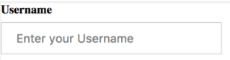
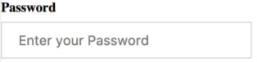
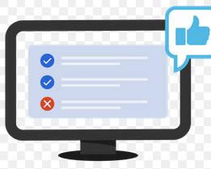
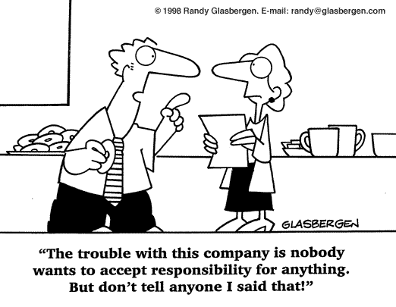
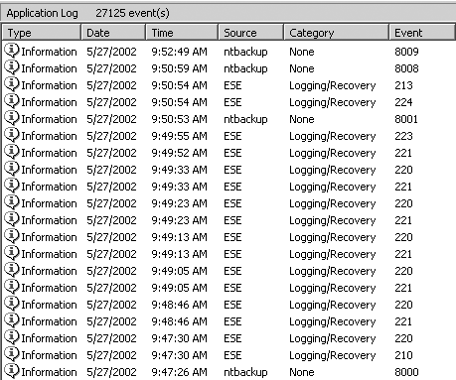
Beyond CIA: Access Control
Notes:
Confidentiality, integrity, and availability are only the beginning of the information security story. Beginning at the beginning, consider the situation when customer Bob logs on to his computer. How does Bob's computer determine that "Bob" is really Bob and not Trudy? And when Bob logs into his account at Alice's Online Bank, how does AOB know that "Bob" is really Bob, and not Trudy? Although these two authentication problems appear to be similar on the surface, under the covers they are actually completely different. Authentication on a standalone computer typically requires that Bob’s password be verified. To do so securely, some clever techniques from the field of cryptography are required. On the other hand, authentication over a network is open to many kinds of attacks that are not usually relevant on a standalone computer. Potentially, the messages sent over a network can be viewed by Trudy. To make matters worse, Trudy might be able to intercept messages, alter messages, and insert messages of her own making. If so, Trudy can simply replay Bob's old messages in an effort to, say, convince AOB that she is really Bob. Since information security people are professional paranoids, we always assume the worst. In any case, authentication over a network requires careful attention to protocol, that is, the composition and ordering of the exchanged messages. Cryptography also has an important role to play in security protocols. Once Bob has been authenticated by Alice's Bank, then Alice must enforce restrictions on Bob's actions. For example, Bob can't look at Charlie’s account balance or install new accounting software on the AOB system. However, Sam, the AOB system administrator, can install new accounting software. Enforcing such restrictions goes by the name of authorization. Note that authorization places restrictions on the actions of authenticated users. Since authentication and authorization both deal with issues of access to resources, we'll lump them together under the clever title of access control.
Identification
Identification is the ability to identify uniquely a user of a system or an application that is running in the system
A subject must provide an identity to a system to start the process of authentication, authorization, and accountability (AAA).
Providing an identity can involve typing in a username; swiping a smart card;
Authentication
The process of verifying or testing that the claimed identity is valid is authentication
Authentication requires from the subject additional information that must exactly correspond to the identity indicated.
This includes the password variations of PINs and passphrases
Authorization
Grant ability to access information (After a person has provided authentication she may have the authority to access the credit card number or enter a room that contains the web server, provided the person has been given prior authorization)
Auditing
Recording a log of the events and activities related to the system and subjects.
Auditing, or monitoring, is the programmatic means by which a subject’s actions are tracked and recorded for the purpose of holding the subject accountable for their actions while authenticated on a system.
Accounting (aka accountability) reviewing log files to check for compliance and violations in order to hold subjects accountable for their actions.
Nonrepudiation ensures that the subject of an activity or event cannot deny that the event occurred.
Nonrepudiation is an essential part of accountability
Nonrepudiation prevents a subject from claiming not to have sent a message, not to have performed an action, or not to have been the cause of an event.
It is made possible through identification, authentication, authorization, accountability, and auditing.
Authenticity: the property of being genuine and being able to be verified and trusted; confident in the validity of a transmission, or a message, or its originator
Accountability: generates the requirement for actions of an entity to be traced uniquely to that individual to support nonrepudiation, deference, fault isolation, forensics etc

Slide 23
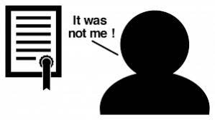
Non-repudiation
Notes:
Confidentiality, integrity, and availability are only the beginning of the information security story. Beginning at the beginning, consider the situation when customer Bob logs on to his computer. How does Bob's computer determine that "Bob" is really Bob and not Trudy? And when Bob logs into his account at Alice's Online Bank, how does AOB know that "Bob" is really Bob, and not Trudy? Although these two authentication problems appear to be similar on the surface, under the covers they are actually completely different. Authentication on a standalone computer typically requires that Bob’s password be verified. To do so securely, some clever techniques from the field of cryptography are required. On the other hand, authentication over a network is open to many kinds of attacks that are not usually relevant on a standalone computer. Potentially, the messages sent over a network can be viewed by Trudy. To make matters worse, Trudy might be able to intercept messages, alter messages, and insert messages of her own making. If so, Trudy can simply replay Bob's old messages in an effort to, say, convince AOB that she is really Bob. Since information security people are professional paranoids, we always assume the worst. In any case, authentication over a network requires careful attention to protocol, that is, the composition and ordering of the exchanged messages. Cryptography also has an important role to play in security protocols. Once Bob has been authenticated by Alice's Bank, then Alice must enforce restrictions on Bob's actions. For example, Bob can't look at Charlie’s account balance or install new accounting software on the AOB system. However, Sam, the AOB system administrator, can install new accounting software. Enforcing such restrictions goes by the name of authorization. Note that authorization places restrictions on the actions of authenticated users. Since authentication and authorization both deal with issues of access to resources, we'll lump them together under the clever title of access control.
Identification
Identification is the ability to identify uniquely a user of a system or an application that is running in the system
A subject must provide an identity to a system to start the process of authentication, authorization, and accountability (AAA).
Providing an identity can involve typing in a username; swiping a smart card;
Authentication
The process of verifying or testing that the claimed identity is valid is authentication
Authentication requires from the subject additional information that must exactly correspond to the identity indicated.
This includes the password variations of PINs and passphrases
Authorization
Grant ability to access information (After a person has provided authentication she may have the authority to access the credit card number or enter a room that contains the web server, provided the person has been given prior authorization)
Auditing
Recording a log of the events and activities related to the system and subjects.
Auditing, or monitoring, is the programmatic means by which a subject’s actions are tracked and recorded for the purpose of holding the subject accountable for their actions while authenticated on a system.
Accounting (aka accountability) reviewing log files to check for compliance and violations in order to hold subjects accountable for their actions.
Nonrepudiation ensures that the subject of an activity or event cannot deny that the event occurred.
Nonrepudiation is an essential part of accountability
Nonrepudiation prevents a subject from claiming not to have sent a message, not to have performed an action, or not to have been the cause of an event.
It is made possible through identification, authentication, authorization, accountability, and auditing.
Authenticity: the property of being genuine and being able to be verified and trusted; confident in the validity of a transmission, or a message, or its originator
Accountability: generates the requirement for actions of an entity to be traced uniquely to that individual to support nonrepudiation, deference, fault isolation, forensics etc

Slide 24
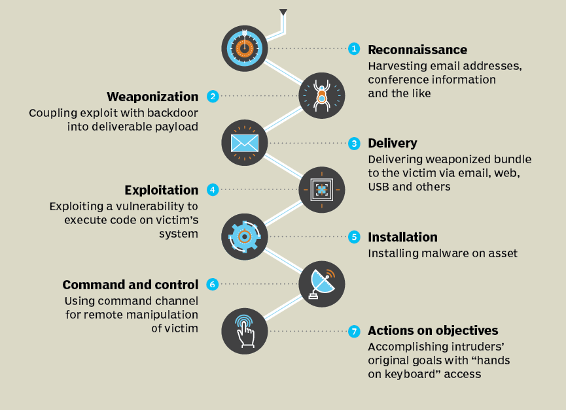
Anatomy of a hack (Cyber Kill Chain)
Notes:
1. Reconnaissance - probe for information about the system: type of hardware or software used
2. Weaponization - attacker creates an exploit (i.e. virus) and packages it into a deliverable payload (i.e. Microsoft Excel)
3. Delivery - weapon is transmitted to the target (such as by an email attachment or through an infected web server)
4. Exploitation - after weapon is delivered, the exploitation stage triggers the intruder’s exploit
5. Installation - the weapon is installed to either attack the computer or install a remote “backdoor”
6. Command and Control - the comprised system connects back to the attacker so that the system can be remotely controlled by the attacker
7. Action on Objectives - now the attackers can start to take actions to achieve their original objectives (lLateral Movement
lObfuscation
lExfiltration
lPrivilege Escalation
)

Slide 25
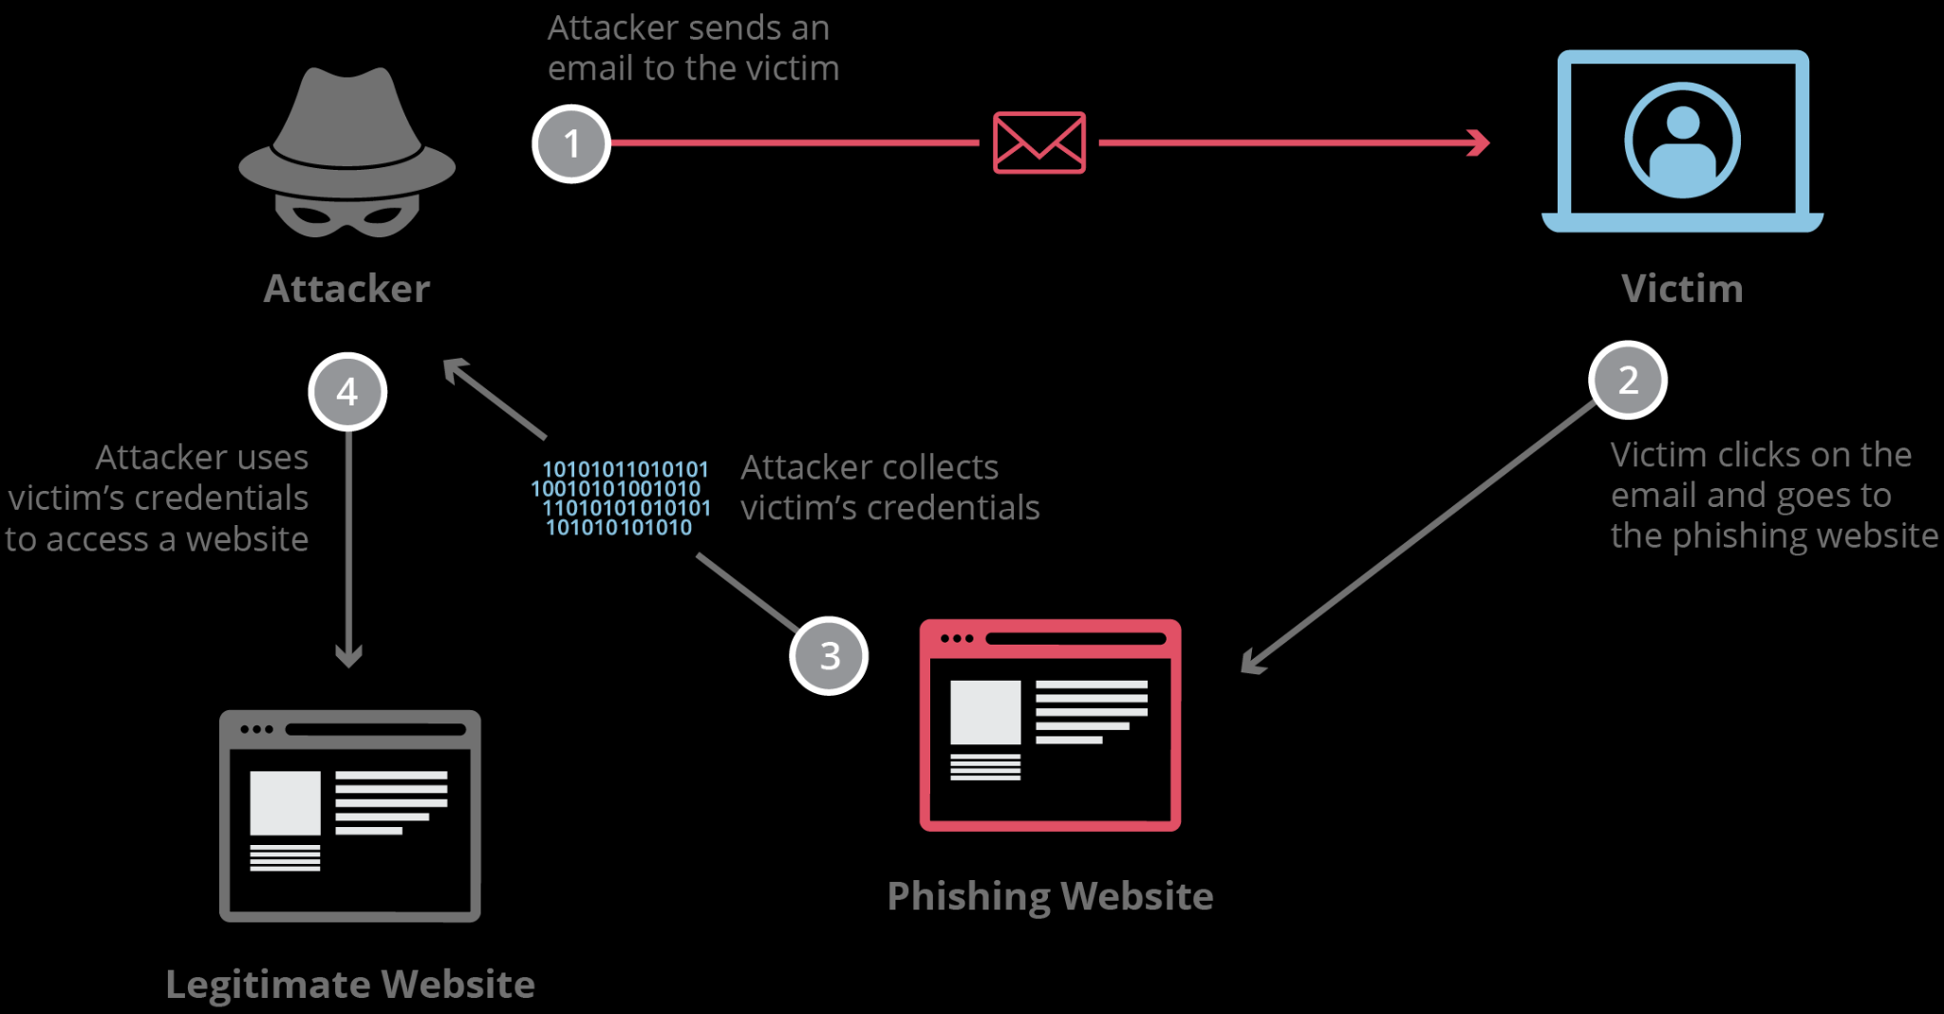
Anatomy of a Hack: Phishing Email

Slide 26
A classic data breach
Prevention: detect phishing urls and mark as spam, train employees to notice phishing, identify offsite access of sensitive files and block, encrypt files so useless if leaked.
Detection: Identify that sensitive files have been (past tense) accessed from off site
Response: Change employee’s password, notify CTO, notify insurer, begin post-breach plan.

Slide 27
Overall Strategy
An overall strategy for providing security
Policy (specs): what security schemes are supposed to do
Assets and their values
Potential threats
Ease of use vs security
Cost of security vs cost of failure/recovery
Implementation/mechanism: how to enforce
Prevention
Detection
Response
Recovery
Correctness/assurance: does it really work (validation/review)

Slide 28

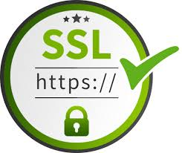
Case study: Heartbleed!
SSL is the main protocol for secure (encrypted) online communication!.
The SSL standard includes a heartbeat option, which allows a computer at one end of an SSL connection to send a short message to verify that the other computer is still online and get a response back.
Researchers found that it's possible to send a cleverly formed, malicious heartbeat message that tricks the computer at the other end into divulging secret information.

Slide 29
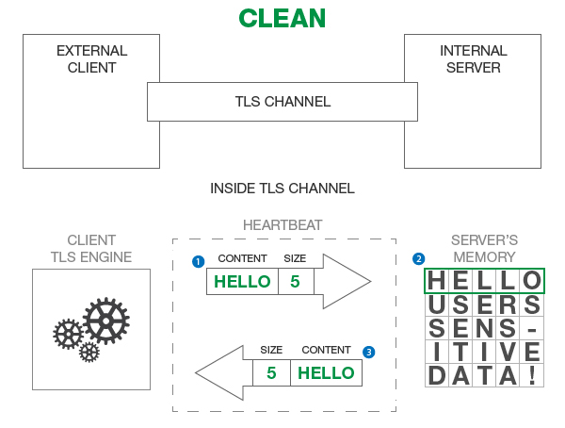
Case study: Heartbleed!
https://www.forumsys.com/api-security/how-to-fix-openssl-heartbleed-security-flaw/
Notes:
SSL is the main protocol for secure (encrypted) online communication!.
The SSL standard includes a heartbeat option, which allows a computer at one end of an SSL connection to send a short message to verify that the other computer is still online and get a response back.
Researchers found that it's possible to send a cleverly formed, malicious heartbeat message that tricks the computer at the other end into divulging secret information.
Please note that in the real world, the message content, as shown above, is not the actual representation of the Heartbeat exchange. We are picking arbitrary message content to simplify the example. The following steps describe the interaction between the client and server:
The client sends a message of size 5 bytes and the data content “HELLO”. If you count the number of characters in the word “HELLO”, the number corresponds to the 5 bytes included in the message (1 byte = 1 letter).
The server receives the message content “HELLO” and stores it in its memory so it can send it back as a “Heartbeat” response. There is also additional data stored in the server’s memory from other TLS channels that the server may have established with other clients. We represent that other data as “USERS SENS-ITIVE DATA!”.
The server then sends exactly the 5 byte message response which exactly corresponds to “HELLO” in server’s memory. The server does not leak any sensitive data from its memory.

Slide 30
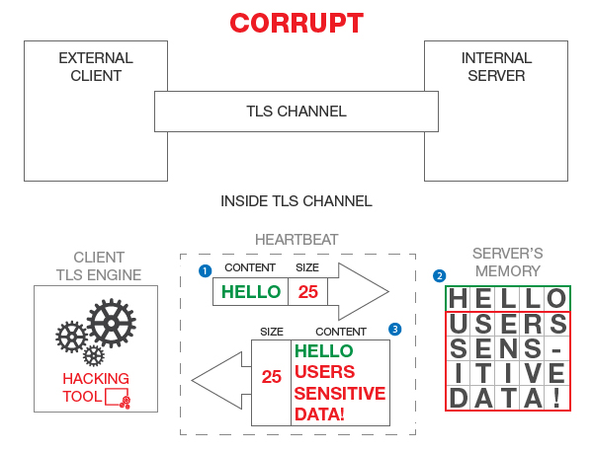
Case study: Heartbleed!
Notes:
The figure above illustrates a corrupt “Heartbeat” message flow where the attacker sends an incorrect size with the “HELLO” message content.
In this example, here are the three steps in the TLS channel work:
The client sends a message with size 25 of bytes but the content of the message really only contains 5 bytes (“HELLO”).
The server receives the message content “HELLO” and stores it in its memory so it can send it back as a “Heartbeat” response. Just like before, there is other data stored in the server memory from other different TLS channels.
The server then sends a 25 byte message response which exactly corresponds to number of characters in “HELLO” plus “USERS SENS-ITIVE DATA!” in server’s memory.
Malformed packet allows you to see server memory!
Passwords, keys, emails, visitor logs …..!
The attacker can ask for around 64,000 characters of plain text. And it doesn't just ask once, it can send malicious heartbeat messages over and over again, allowing the attacker to get back different fragments of the server's memory each time.
Fix: Don’t let the user tell you how much data to send back!!
This is a design ﬂaw

Slide 31
Understanding the Importance of Information Security
Information security can be helpful in:
Preventing data theft
Thwarting identity theft
Avoiding the legal consequences of not securing information
Maintaining productivity
Foiling cyberterrorism
Notes:
Preventing Data Theft
Business data theft involves stealing proprietary business information
Personal data theft involves stealing credit card numbers
Identity theft
Stealing another person’s personal information, usually using it for financial gain
Example: Steal person’s SSN, Create new credit card account to charge purchases and leave them unpaid, File fraudulent tax returns
Laws protecting electronic data privacy:
The Health Insurance Portability and Accountability Act of 1996 (HIPAA)
The Sarbanes-Oxley Act of 2002 (Sarbox)
The Gramm-Leach-Bliley Act (GLBA)
Payment Card Industry Data Security Standard (PCI DSS)
California’s Database Security Breach Notification Act (2003)
Post-attack clean up diverts resources away from normal activities
Time, money, and other resources
Cyberterrorism
Any premeditated, politically motivated attack against information, computer systems, computer programs, and data
Designed to cause panic, provoke violence, result in financial catastrophe
May be directed at targets such as the banking industry, power plants, air traffic control centers, and water systems

Slide 32
Who Are the Attackers?
Hacker - person who uses computer skills to attack computers
Black hat hackers
Violate computer security for personal gain and the goal is to inflict malicious damage
White hat hackers
Goal to expose security flaws, not to steal or corrupt data
Gray hat hackers
Goal is to break into a system without owner’s permission, but not for their own advantage
Notes:
Who Are the Attackers?
Hacker - person who uses computer skills to attack computers
Black hat hackers
Violate computer security for personal gain and the goal is to inflict malicious damage
White hat hackers
Goal to expose security flaws, not to steal or corrupt data
Gray hat hackers
Goal is to break into a system without owner’s permission, but not for their own advantage

Slide 33
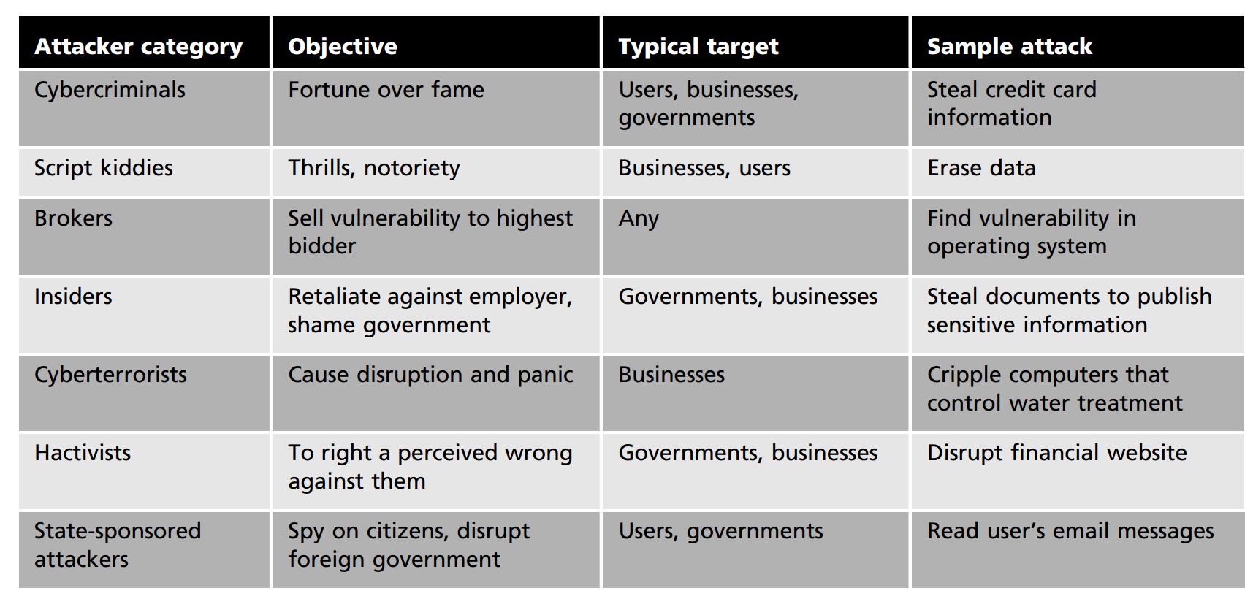
Who Are the Attackers?
Notes:
Cybercriminals
A network of attackers, identity thieves, spammers, financial fraudsters
More highly motivated
Willing to take more risk
Well-funded
More tenacious
The goal of a cybercriminal is financial gain
Cybercrime - targeted attacks against financial networks and the theft of personal information
Financial cybercrime is divided into two categories:
Individuals and businesses
Use stolen data, credit card numbers, online financial account information, or Social Security numbers to profit from victims
Businesses and governments
Attempt to steal research on a new product so they can sell it to an unscrupulous foreign supplier
Advanced Persistent Threat (APT) - multiyear intrusion campaign that targets highly sensitive economic, proprietary, or national security information
Script Kiddies
Script kiddies - individuals who want to attack computers yet they lack the knowledge of computers and network needed to do so
They download automated hacking software (scripts) from websites
Over 40 percent of attacks require low or no skills
Exploit kits - automated attack package that can be used without an advanced knowledge of computers
Script kiddies either rent or purchase them
Traditional Motives
Motivated by thrill, validation of skills, sense of power
Motivated to increase reputation among other hackers
Often do damage as a byproduct
Often engage in petty crime
Brokers
Brokers - attackers who sell knowledge of a vulnerability to other attackers or governments
Often hired by the vendor to uncover vulnerabilities
Instead they do not report it to the vendor but sell the information about the vulnerabilities to the highest bidder
Employees, contractors, and business partners
Over 48 percent of breaches attributed to insiders
Examples of insider attacks:
Health care worker may publicize celebrities’ health records
Disgruntled over upcoming job termination
Stock trader might conceal losses through fake transactions
Employees may be bribed or coerced into stealing data before moving to a new job
Cyberterrorists - an attacker whose motivation may be ideological or for the sake of principles or beliefs
Almost impossible to predict when or where the attack may occur
Targets may include:
A small group of computers or networks that can affect the largest number of users
Example:
Computers that control the electrical power grid of a state or region
Hactivists
Hactivists - attackers who attack for ideological reasons that are generally not as well-defined as a cyberterrorist’s motivation
Examples of hactivist attacks:
Breaking into a website and changing the contents on the site to make a political statement
Disabling a website belonging to a bank because the bank stopped accepting payments that were deposited into accounts belonging to the hactivists
State-sponsored attacker - an attacker commissioned by the governments to attack enemies’ information systems
May target foreign governments or even citizens of the government who are considered hostile or threatening
Advanced Persistent threats (As the name "advanced" suggests, an advanced persistent attack (APT) uses continuous, and sophisticated hacking techniques to gain access to a system and remain inside for a prolonged period of time, with potentially destructive consequences.
APTs are usually leveled at high value targets, such as nation states and large corporations, with the ultimate goal of stealing information over a long period of time.
)
Examples of attacks:
Malware targeting government or military computers
Citizens having their email messages read without their knowledge

Slide 34
Back to the Castle

Slide 35
Fundamental Security Principles for Defense
Five fundamental security principles for defenses:
Layering
Limiting
Diversity
Obscurity
Simplicity
Notes:
Layering
A single defense mechanism may be easy to circumvent
Making it unlikely that an attacker can break through all defense layers
Can be useful in resisting a variety of attacks
Provides the most comprehensive protection
Limiting access to information:
Only those who must use data should be granted access
Should be limited to only what they need to do their job
Methods of limiting access ( Technology-based - such as file permissions, Procedural - such as prohibiting document removal from premises)
Diversity
Layers must be different (diverse)
If attackers penetrate one layer, Same techniques will be unsuccessful in breaking through other layers
Breaching one security layer does not compromise the whole system
Example of diversity, Using security products from different manufacturers
Obscurity
Obscuring inside details to outsiders
Example: not revealing details (Type of computer, Operating system version, Brand of software used)
Difficult for attacker to devise attack if system details are unknown
Simplicity
Complex security systems:
Can be difficult to understand and troubleshoot
Are often compromised for ease of use by trusted users

Slide 36
Fundamental Security Principles for Design
Despite years of research, it is still difficult to design systems that comprehensively prevent security flaws
But good practices for good design have been documented (analogous to software engineering)
Economy of mechanism, fail-safe defaults, complete mediation, open design, separation of privileges, least privilege, least common mechanism, psychological accountability, isolation, encapsulation, modularity, layering, least astonishment
Notes:
Economy of mechanism: the design of security measures should be as simple as possible
Simpler to implement and to verify
Fewer vulnerabilities
Fail-safe default: access decisions should be based on permissions; i.e., the default is lack of access
Complete mediation: every access should checked against an access control system
Open design: the design should be open rather than secret (e.g., encryption algorithms)
Isolation
Public access should be isolated from critical resources (no connection between public and critical information)
Users files should be isolated from one another (except when desired)
Security mechanism should be isolated (i.e., preventing access to those mechanisms)
Encapsulation: similar to object concepts (hide internal structures)
Modularity: modular structure
Layering (defense in depth): use of multiple, overlapping protection approaches
Least astonishment: a program or interface should always respond in a way that is least likely to astonish a user
Separation of privilege: multiple privileges should be needed to achieve access (or complete a task)
Least privilege: every user (process) should have the least privilege to perform a task (role based access control)
Least common mechanism: a design should minimize the function shared by different users (providing mutual security; reduce deadlock)
Psychological acceptability: security mechanisms should not interfere unduly with the work of users

